Slide 1
Semantic Analysis and Intermediate code generation

Slide 2

Infix to postfix translator

Slide 3
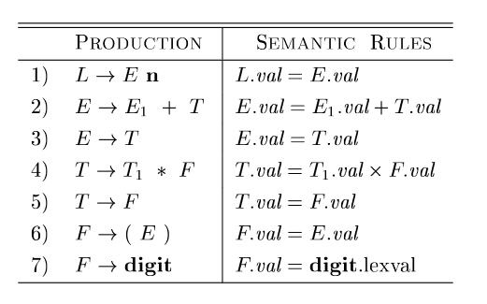
Syntax directed definitions
A syntax directed definition is a context free grammar with attributes and rules.

Slide 4
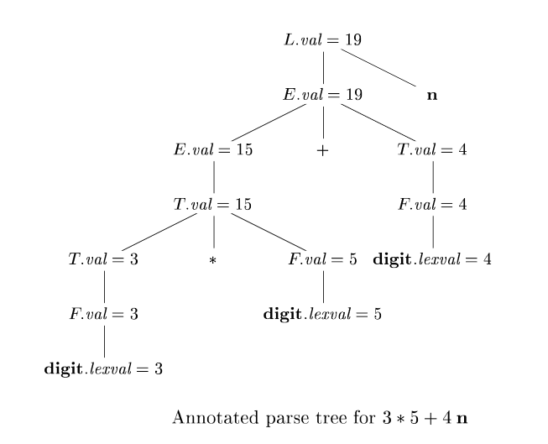
Annotated parse tree

Slide 5
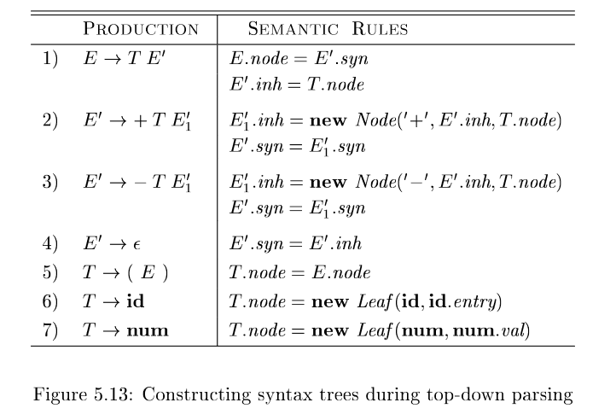
Syntax tree

Slide 6
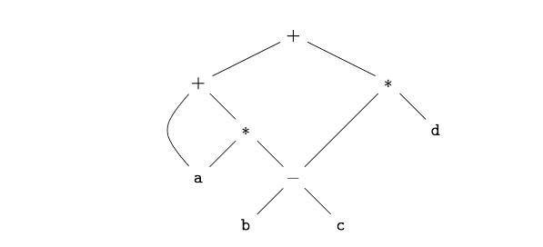
Variants of syntax tree
Directed acyclic graph

Slide 7
